Slide 1



E-CODEATHON
VASUDA
Giving the land what it needs
AYA SHER

Slide 2
E-CODEATHON
BEHAVIOR-AWARE SOIL HEALTH RISK INTELLIGENCE SYSTEM
VasuDA

Slide 3
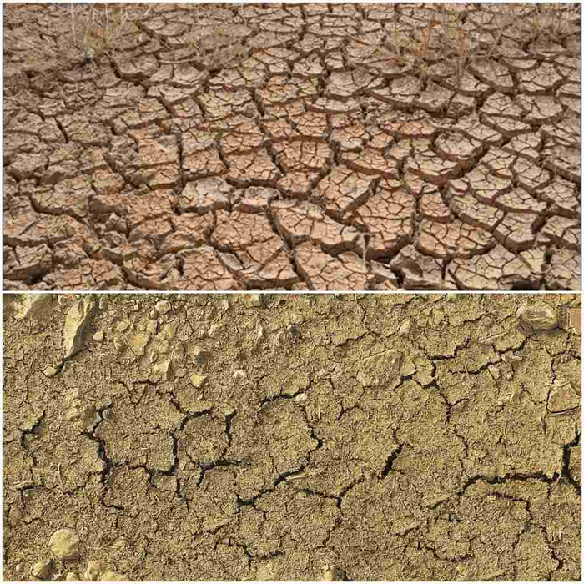
E-CODEATHON
PROBLEM TARGETED
SOIL DEGRADATION IN INDIA IS PRIMARILY DUE TO UNSTABLE FARMING PRACTICES.
EXISTING SOLUTIONS ARE INFREQUENT, REACTIVE, AND LAB DEPENDENT
FARMERS LACK A SYSTEM THAT LINKS FARMING PRACTICES TO LONG TERM SOIL HEALTH
VasuDA

Slide 4
E-CODEATHON
PROBLEM TARGETED
THIS SYSTEM DOES NOT MERELY MEASURE SOIL HEALTH — IT CHANGES FARMING BEHAVIOR TO PROTECT SOIL FOR FUTURE GENERATIONS.
VasuDA

Slide 5




E-CODEATHON
SDG RELEVANCE
VasuDA

Slide 6
E-CODEATHON
OUR SOLUTION
Soil
Health Risk
Score
Sense & Capture
Trigger
Intelligence
Advice &
Act
VasuDA

Slide 7
E-CODEATHON
OUR SOLUTION
1
SENSORS
PH
SOIL
TEMP.
SOIL MOISTURE
AIR TEMP. & HUM.
VasuDA

Slide 8
E-CODEATHON
OUR SOLUTION
1
FARMER’S INPUT
CROP TYPE
FERTILIZER
FREQUENCY
IRRIGATION FREQUENCY
VasuDA

Slide 9
E-CODEATHON
OUR SOLUTION
2
SHRS
(Soil Health Risk Score)
Process the data using a rule‑based engine to compute the Soil Health Risk Score
VasuDA

Slide 10
E-CODEATHON
OUR SOLUTION
3
TRIGGER INTELLIGENCE
When risk thresholds are crossed, activate the AI layer to generate controlled, regenerative farming advisories.
VasuDA

Slide 11
E-CODEATHON
OUR SOLUTION
4
Advise and ACT
Deliver clear, region‑specific sustainable recommendations to the farmer via the dashboard for informed action.
VasuDA

Slide 12
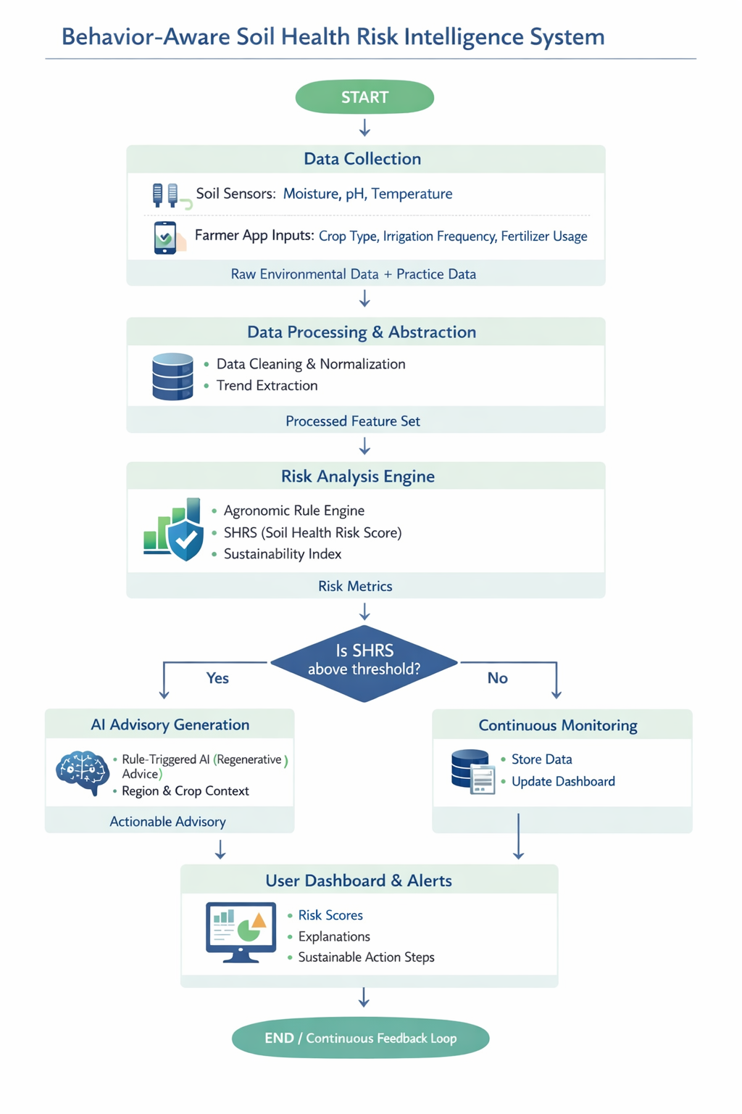
E-CODEATHON
WORKFLOW
VasuDA

Slide 13
E-CODEATHON
WORKFLOW
VasuDA

Slide 14
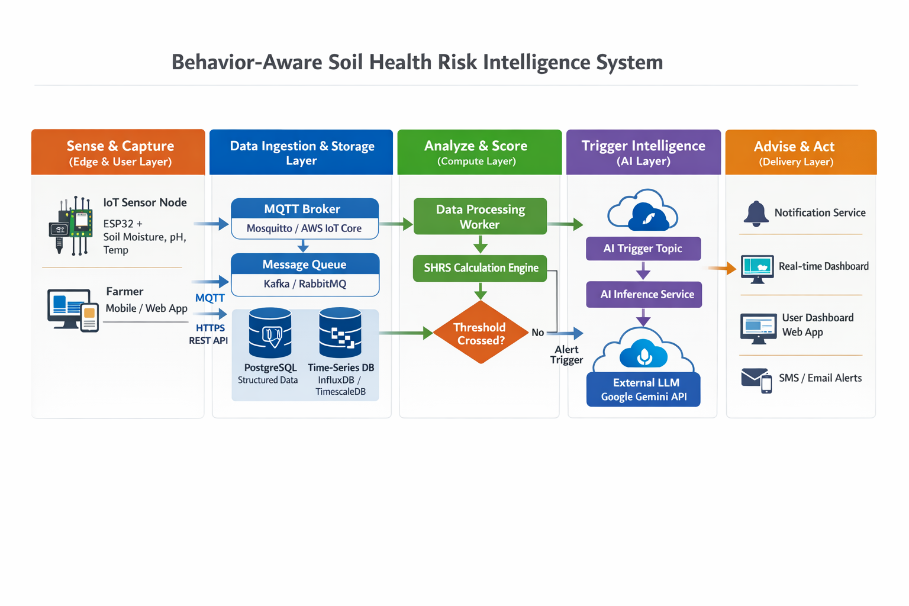
E-CODEATHON
ARCHITECTURE
VasuDA

Slide 15
E-CODEATHON
SIGNIFICANCE
PREVENTS LONG‑TERM SOIL DEGRADATION BY IDENTIFYING RISKY FARMING PRACTICES EARLY, BEFORE YIELD LOSS OCCURS.
ENABLES SUSTAINABLE DECISION‑MAKING THROUGH EXPLAINABLE RISK SCORING AND REGENERATIVE, AI‑ASSISTED ADVISORIES.
SUPPORTS SDG‑ALIGNED AGRICULTURE BY IMPROVING FOOD SECURITY, REDUCING CHEMICAL OVERUSE, AND PROTECTING SOIL ECOSYSTEMS.
VasuDA

Slide 16
E-CODEATHON
TEAM MEMBERS
DIVYANSHU SINGH
KRISHNA YADAV
BASWA NAVNEETH
VasuDA

